Slide 1
SAS Supervisor within You vs SAS: Debugging SAS Data Steps with the Program Data Vector
By Sasikumar Palanisamy

Slide 2
Agenda
Introduction
SAS Supervisor
SAS Data Step
Compilation Phase
Execution Phase
Return Controls
What is PDV?
Data flow Process through PDV
Summary

Slide 3
Introduction
The SAS DATA Step is a primary method you have used to create SAS data sets. Most of the time they work as expected but sometimes they don’t. Sometimes you know why and sometimes don’t. Stuck in a rut, scratching your head. What went wrong and where? Does this describe you, then let’s talk.

Slide 4
SAS Supervisor
SAS Supervisor controls the execution flow of a SAS job and it has a look ahead capability.
Why learn about SAS Supervisor?
To know how SAS program is structured and controlled.
To know how to examine SAS code from the supervisor point-of-view.
SAS Supervisor is keyword Driven
DATA Step
Example – input, infile, put, if-then
PROC Step
Example – var, id, table, class
Anywhere
Example – title, options

Slide 5
SAS DATA Step
SAS DATA step consists of a group of SAS statements that begins with a DATA statement.
The statements that make up the DATA step are compiled, and the syntax is checked. If the syntax is correct, then the statements are executed. In its simplest form, the DATA step is a loop with an automatic output and return action.
New SAS Data Set
Compilation Phase
Execution Phase
Descriptor Portion
Data Portion

Slide 6
Compilation Phase
During this phase, each of the statements within the data step are scanned for syntax errors.
Input Buffer, PDV & Descriptor portion of SAS dataset gets created at the end of compilation phase
compiles
SAS statements
(includes syntax checking)
creates
an input buffer
a program data vector
descriptor information

Slide 7
Execution Phase
Initialization of variables in the PDV to missing
Execution of the DATA Step Program
Outputting or copying values of variables in the PDV to the output SAS data set.
Repeating above steps until the input data source is exhausted.

Slide 8
Execution Phase
Begins
with a DATA statement (counts iterations)
sets
variable values to missing in the PDV
Data-reading statement; is there a record to read?
closes
Data set; goes on to the next DATA or PROC step
No
Yes
reads
an input record
executes
additional executable statements
writes
An observation to the SAS data set
returns
To the beginning of the DATA Step

Slide 9
Return Controls
SAS Statements which return Control to SAS Supervisor
ABORT or STOP:
If abort or Stop statement is executed control will be passed to SAS supervisor.
Implied Return:
It is executed whenever you reach the bottom of the data step.
Delete Statement:
Execution of a delete statement passes control to the SAS supervisor.
Subsetting If Statement:
If expression evaluates as false control is returned to the SAS supervisor.
Return Statement:
Execution of a Return statement passes control to the SAS supervisor.
Failed read operation:
If a read-operation (input, set, merge) fails it passes to SAS supervisor.

Slide 10
What is PDV?
The Program Data Vector is a logical area of memory that is created during the data step processing.
SAS builds a SAS dataset by reading one observation at a time into the PDV and, unless given code to do otherwise, writes the observation to a target dataset.
The program data vector contains two types of variables.
Permanent (data set and computed variables)
Temporary (automatic and option defined)
Automatic (_N_ and _ERROR_)
Option defined (e.g., first.by-variable, last.by-variable, in=variable, end=variable)

Slide 11
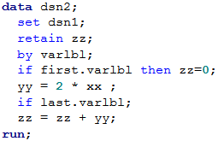
Data Flow Process through PDV
_N_ | _ERROR_ | FIRST.varlbl | LAST.varlbl | varlbl | xx | yy | zz
VARLBL | XX
aa | 5
bb | 8
bb | 3
_N_ | _ERROR_ | FIRST.varlbl | LAST.varlbl | varlbl | xx | yy | zz
1 | 0 | 1 | 1 |  | . | . | .
_N_ | _ERROR_ | FIRST.varlbl | LAST.varlbl | varlbl | xx | yy | zz
1 | 0 | 1 | 1 | aa | 5 | 10 | 10
VARLBL | XX | YY | ZZ
aa | 5 | 10 | 10
bb | 3 | 6 | ??

Slide 12
Data Flow Process through PDV
Here is a quick math for ‘bb’ records –
1st record
xx = 8; yy = 2 * 8 = 16; zz = 0 + 16 = 16;
2nd record
xx = 3; yy = 2 * 3 = 6; zz = 16 + 6 = 22; ** since zz is retained.
But “22” is in-correct as per the SAS Supervisor.
VARLBL | XX
aa | 5
bb | 8
bb | 3

Slide 13
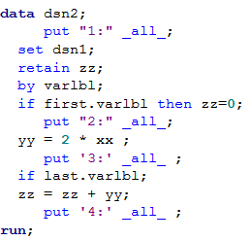
Data Flow Process through PDV
SAS answer is 6.
What went wrong in the logic? How to debug?
Let’s use PDV to look the processing closer.
Adding 4 put statement to debug the

Slide 14
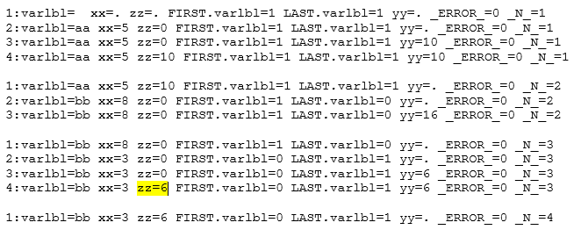
Data Flow Process through PDV
Here is the result from log –
SAS didn’t output 4th put statement for first ‘bb’ record - since we had subset “if” statement with last.varlbl - so SAS ignored following statements and passed control back to top of DATA Step to read in next record.

Slide 15
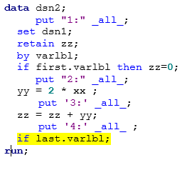
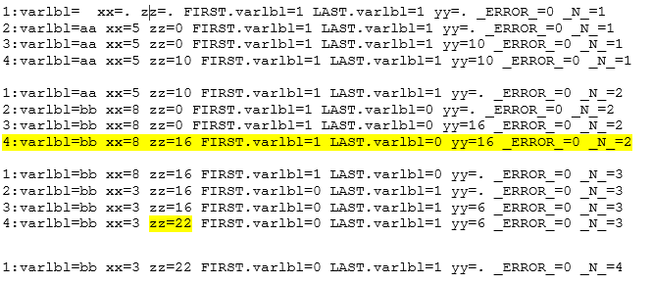
Data Flow Process through PDV
Moved “if last.varlbl” as last statement.
VARLBL | XX | YY | ZZ
aa | 5 | 10 | 10
bb | 3 | 6 | 22

Slide 16
Summary
We should think like SAS supervisor!
Data Step process
Compilation Phase
Execution Phase
Return Controls
PDV and it’s importance.

Slide 17
Thanks to:
PhilaSUG 2016 for the opportunity to present.
Terek Peterson for reviewing this presentation and providing me the guidance.

Slide 18
Contact Information
Sasikumar Palanisamy
Chiltern International Ltd.
1016 W 9th Ave,
King of Prussia, PA
(484)-679-2689
Sasikumar.Palanisamy@chiltern.com

