Slide 1
Is Your Randomization Really Random?
By: Arteid Memaj and Carolyn Romano

Slide 2
Agenda
Describe Random Number Generator
Code and output
Describe Proc Plan
Options
Code and output
Wald-Wolfowitz (or Runs) test for randomness
SAS Procedure?
Run Statistical Test on randomly generated datasets
Compare the two
Final Thoughts

Slide 3
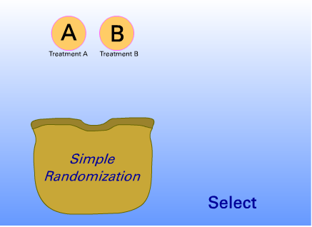
What is a Randomization?
Randomization in clinical trials is used to test efficacy and effectiveness of medicines, medical devices, or surgery.
It is effective in reducing biases since it guarantees that treatment assignment will not be based on a patient’s prognostic factors.
Using a Randomization procedure takes the following into consideration:
Reducing bias
Producing a balanced comparison
Quantifying errors attributable to chance
Notes:
Assigning research participants by change – to treatment groups or a control group

Slide 4
How is a Randomization Created: Data steps
proc format;
value treatn 1='A'
2='B';
value $treatc 'A'='Study Drug 500 mg'
'B'='Placebo';
run;
%macro repeat(n);
%do i=1 %to &n;
data rand&i;
do unit = 1 to 300; output;
end;
run;
data rand1&i;
set rand&i;
random=ranuni(&i);
run;
proc sort data=rand1&i;
by unit;
run;
data rand2&i;
set rand1&i;
id=_N_ + 1000;
if random le 2/3 then group=1;
if random gt 2/3 then group=2;
typecode=put(group,treatn.);
therdesc=put(typecode,$treatc.);
run;
%end;
%mend repeat;
%repeat(10);
In this randomization, there are:
300 subjects
2 treatment groups
Treatment allocation ratio is approximately 2(Study drug) to 1 (Placebo)
Using ranuni() generates a number from a U(0,1) distribution

Slide 5
How is a Randomization Created: Data steps

Slide 6
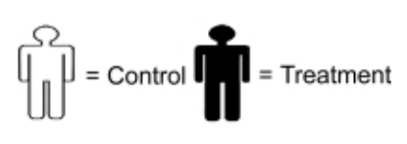
How is a Randomization Created: The PLAN Procedure
Proc Plan generates a list of random numbers based on a uniform random distribution
A seed number (any positive integer $≤$2³¹-1) can be used.
Note that if a seed number is not provided, SAS will use the time of the day
Proc Plan randomizes plans for factorial experiments and is used for generating lists of combinations and permutations of numbers.
Notes:
Using time of day can result in generating artificial correlations – so this Is not recommended

Slide 7
The PLAN Procedure: <options>
You must specify the proc plan statement and at least one factors statement before running.
<options>: SEED=option to start the random number generator with a specific number
Note: you can leave as SEED=;
An ORDERED statement can be added in this section also.

Slide 8
The PLAN Procedure: FACTORS
FACTORS: varname=m<OF n> <selection-type> (m<=n if in is selected)
FACTORS specifies the factors of the plan and generates the plan
<selection type> allows us to specify the method of selecting m values.
COMB, CYCLIC, ORDERED, PERM, RANDOM
By default, the selection type is random unless you use ORDERED in the <options>
NOPRINT: this option temporarily disables the Output Delivery System (ODS)
Notes:
more than one factor selection can be used in a FACTORS statement.
m is a positive integer that gives the number of values to be selected and n gives the # of values to be selected from.

Slide 9
The PLAN Procedure: FACTORS examples
RANDOM: selects m in a random order when m is a positive integer
Ex. factors a=6
ORDERED: selects m in order starting with 1, 2, … m.
Ex. factors a=6 ordered
PERM: cycles through all m! permutations
Ex. factors t=5 perm (this will output 1,2,3,4,5, 1,2,3,5,4 … 5,4,3,1,2, 5,4,3,2,1)
COMB: cycles through all n!/(m!(n-m)!) combinations
Ex. factors t=3 of 5 comb (this will output combinations of 3 integers 1-5. 1,2,3 , 3,4,5, …)
CYCLIC: this cyclically permutes m by n.
Ex. factors t=5 of 30 cyclic (this will output 1,2,3,4,5, 2,3,4,5,6, … 29,30,1,2,3, 30,1,2,3,4 …)
Notes:
By default, the selection-type is RANDOM, unless you use the ORDERED option in the PROC PLAN statement. In this case, the default selection type is ORDERED.

Slide 10
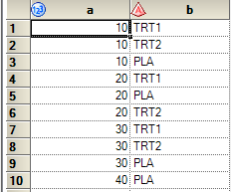
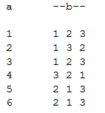
The PLAN Procedure: OUTPUT
The OUT=option outputs the last plan generated for the specified data set.
Two different options you can have OUTPUT OUT=
proc plan;
factors a=6 ordered
b=3;
output out=design a nvals=(10 to 60 by 10)
b cvals=(’TRT1’ ’TRT2’ ’PLA’);
run;
Notes:
NVALS: lists n numeric values for the factor. By default, the procedure uses NVALS=(1 2 3…n)
CVALS: lists n character strings for the factor. Each string can have up to 40 characters, and each string must be enclosed in quotes

Slide 11
The PLAN Procedure: TREATMENTS
TREATMENTS statement specifies the treatments of the plan to generate.
The TREATMENTS statement uses the same form as the FACTORS statement.
proc plan;
factors r=3 ordered
c=3 ordered;
treatments a=3 cyclic
b=3 cyclic 2;
run;
Notes:
First the FACTORS statement sets up the rows and columns of a 3x3 square. Then, the TREATMENTS statement augments the
square with two cyclic treatments.

Slide 12
Example: PROC PLAN Randomization of Two Treatments
proc format;
value $treatn '-1'='A'
'1'='B';
value $treatc 'A'='Study Drug 500 mg'
'B'='Placebo';
run;
%macro repeat(n);
%do i=1 %to &n;
proc plan seed=&i;
factors block=30 ordered
treatn=10 random;
output out=first&i;
treatments t=15 random;
run;
proc sort data=first&i;
by block;
run;
data rand_&i;
length trt $2.;
set first&i;
if t in(1,2,3,4,5,6,7,8,9,10) then trt = ‘-1';
else trt = '1';
run;
data second&i;
set rand_&i;
id=_N_ + 1000;
typecode=put(trt,treatn.);
therdesc=put(typecode,$treatc.);
run;
%end;
%mend repeat;
%repeat(10);
In this randomization, there are:
30 different blocks
10 patients per block
2 treatment groups
Treatment allocation ratio is 2(Study drug) to 1 (Placebo)
You have the choice to leave seed=; then the randomization will be different every time it’s run.

Slide 13
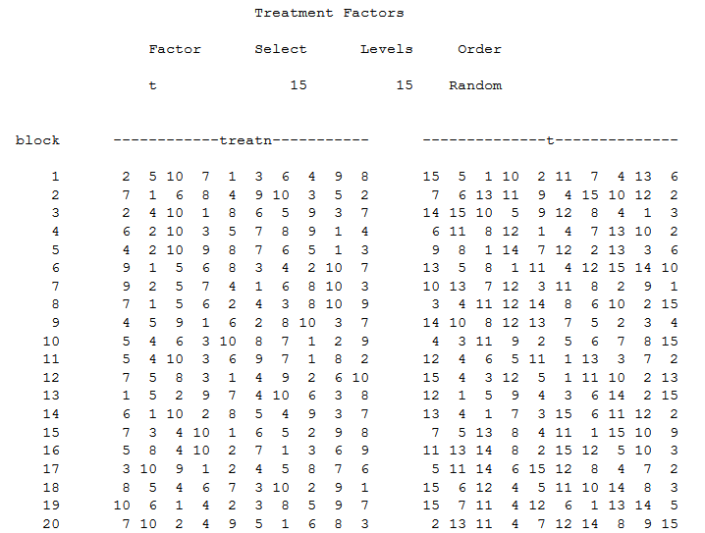
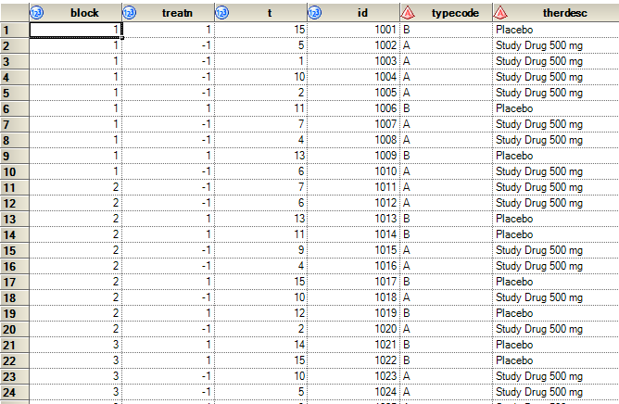
Example: Continued
Notes:
On the left, here are the 30blocks with 10 pts/block. You can see these 10 pts being put in a random order.

Slide 14
Wald-Wolfowitz (or Runs) test for randomness
Non-parametric statistical test
Tests (two-valued data sequence) for randomness.
Looks at the “run”:
Sequence consisting of adjacent equal elements
$H_{0}:$ The number of Runs in a sequence of N elements
~ N($μ= \frac{2 N_{+}N_{−}}{N}+1$ , $σ^{2}= \frac{(μ −1)(μ −2)}{N−1}$ )

Slide 15
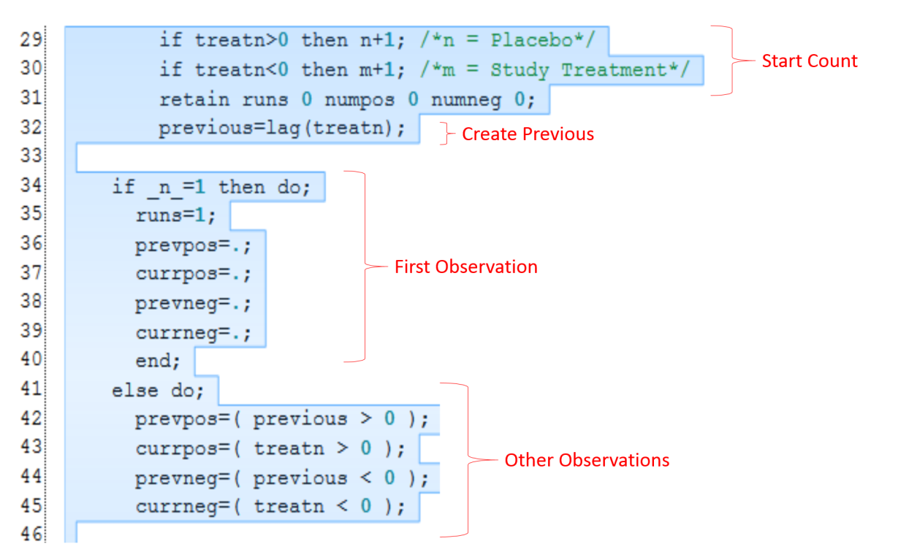
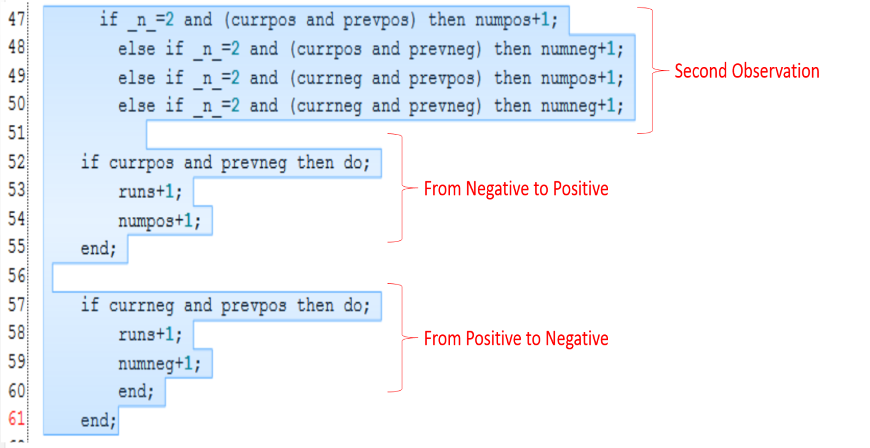
Wald-Wolfowitz in SAS
No SAS procedure: (Manually count: total number of runs, number of “+”, Number of “-”)
Following manual steps:
Convert two treatments to “+” and “-”

Slide 16
General Idea of Syntax

Slide 17
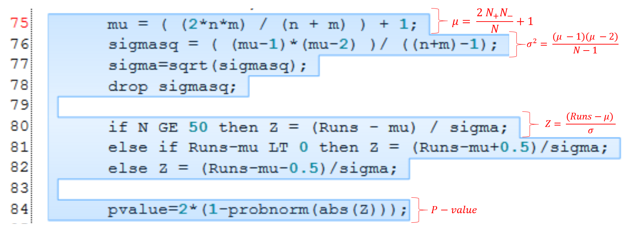
Final Dataset

Slide 18
Results Proc Plan
2 Reject the null hypothesis at the α = .05 level
8 Fail to reject the null hypothesis at the α = .05 level

Slide 19
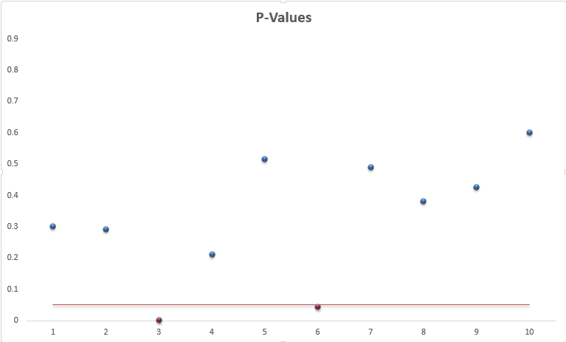
Results Random Number Generator
2 Reject the null hypothesis at the α = .05 level
8 Fail to reject the null hypothesis at the α = .05 level

Slide 20
Comparing the runs that failed to reject the $H_{0}$
Proc Plan
Random Number Generator
Placebo | Study Drug | Run | P-Value
217 | 83 | 137 | 0.0213
210 | 90 | 123 | 0.5815
187 | 113 | 133 | 0.2744
192 | 108 | 132 | 0.3634
199 | 101 | 132 | 0.6982
207 | 93 | 137 | 0.3002
203 | 97 | 135 | 0.7184
230 | 70 | 111 | 0.6660
201 | 99 | 151 | 0.0233
196 | 104 | 138 | 0.8876
Placebo | Study Drug | Run | P-Value
196 | 104 | 145 | 0.3005
202 | 98 | 141 | 0.2911
210 | 90 | 152 | 0.0006
197 | 103 | 146 | 0.2120
199 | 101 | 140 | 0.5166
194 | 106 | 154 | 0.0440
198 | 102 | 141 | 0.4896
208 | 92 | 135 | 0.3818
206 | 94 | 136 | 0.4270
196 | 104 | 141 | 0.5999

Slide 21
Comparing the runs that failed to reject the $H_{0}$ (1:1)
Proc Plan
Random Number Generator
Placebo | Study Drug | Run | P-Value
152 | 148 | 163 | 0.1641
149 | 151 | 151 | 0.9994
156 | 144 | 156 | 0.5438
149 | 151 | 160 | 0.2975
149 | 151 | 155 | 0.6430
156 | 144 | 166 | 0.0775
150 | 150 | 165 | 0.1054
146 | 154 | 163 | 0.1611
147 | 153 | 171 | 0.0203
150 | 150 | 169 | 0.0373
Placebo | Study Drug | Run | P-Value
151 | 149 | 157 | 0.4872
160 | 140 | 137 | 0.1214
135 | 165 | 138 | 0.1791
146 | 154 | 152 | 0.8981
150 | 150 | 134 | 0.0493
150 | 150 | 149 | 0.8171
149 | 151 | 153 | 0.8165
168 | 132 | 141 | 0.3575
147 | 153 | 157 | 0.4832
153 | 147 | 143 | 0.3582

Slide 22
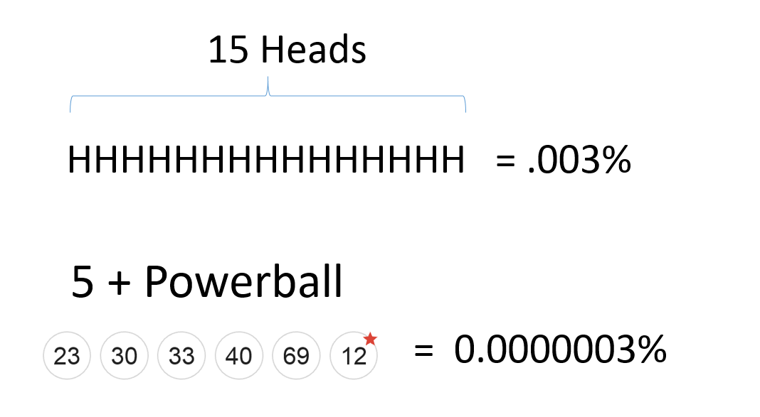
Final Thoughts: Is your randomization really random?
Random: Without definite aim, direction, rule, or method.
Can the randomization be rerun if it rejects the null in Wald-Wolfwitz?
If so, how many times are you allowed to rerun?
If so do we have an aim/direction/rule?

Slide 23
Thanks! Any Questions?

