Slide 1

Dealing with Variable Length Mainframe Files (EBCDIC) in an ASCII Environment
PhilaSUG Spring Meeting June 12, 2014
©2014 Automated Financial Systems, Inc. All Rights Reserved. AFS and all AFS product trademarks are registered trademarks of Automated Financial Systems, Inc. The content of this document represents confidential and proprietary information of AFS. This information may not be disclosed to any third party, other than the direct addressee and its employees, agents, and representatives. The infringement of this prohibition may violate AFS proprietary and trade secret rights with resulting irreparable damage to AFS. Your cooperation is requested and appreciated. Thank you for your help in this matter. AFS 123 Summit Drive, Exton, Pennsylvania 19341. Telephone (610) 524-9300 Fax (610) 524-7977

Slide 2
AFS: Who We Are
Building business, enabling regulatory compliant and scalable credit delivery models with experience, expertise, and access through:
40+ Years of providing industry-leading wholesale credit software applications
  AFSVision®
  AFS Level III™
  AFSXpress®
12 Years as an outsourced application service provider
  AFSCommerce®, 9 Banks, $175Bn Daily
  AFS Lender Workstation™, 14 Banks, $275Bn Daily
10 Years of providing information-based solutions for over 100 of the top domestic and global financial institutions through the AFS Best Practices Leadership Council
  AFS Pricing Dashboard: a monthly market practices pricing database; 6 years
  Risk Analysis Benchmarking Service with RMA: credit quality and metrics; 10 years
  Loan Operations Best Practices Benchmarking: cost, throughput, and quality; 8 years
  Data Quality Best Practices: in partnership with RMA; 6 years
  Credit Delivery Model Best Practices Benchmarking: in collaboration with McKinsey; 2011-2013
  RMA/AFS CCAR Stress Test and Data Quality Program; 2013
A proven methodology of applying Industry Best Practices through the AFS Best Practices Leadership Council, to identify and close the credit process, performance, and reporting gaps.

Slide 3








































AFS Benchmarking Clients
Operations
Pricing
and
Revenue
Credit Delivery
Process
Credit Risk
AFS Lending Systems
RMA/AFS
Risk Analysis Service
Pricing
Dashboard
Operational Benchmarking
CCAR
Benchmarking
AFS Benchmarking Services
Notes:
3

Slide 4
AFS Pricing Dashboard
  The industry source for Commercial Lending Pricing Trends
  Includes $1 trillion in commercial loan commitments, with 70,000 new or renewed loans added per quarter
  Twenty-eight banks currently participate, including
    7 of the top 10 banks
    20 of the top 50 banks
  Benchmarking of key loan pricing and volume growth metrics against market peers
  Robust platform for analytics, reporting, and monitoring
Sample data for illustration purposes only.

Slide 5
So what’s the problem?
  Large data sources often come from applications that run on IBM Mainframes. The IBM Mainframe stores data in EBCDIC (Extended Binary Coded Decimal Interchange Code) while smaller organizations and data consumers run on systems that use ASCII (American Standard Code for Information Interchange)
  If the file contains data other than printable characters (like binary or packed decimal), simple conversion techniques cannot be used. The techniques for easy conversions as well as complex (using SAS Formats) will be covered along with methods of viewing the data outside of SAS
  Both the IBM Mainframe and the Windows Server/PC environment will be the focus of this session. The specific tools include IEBGENER, PKZIP, FTP, and UltraEdit, in addition to SAS.

Slide 6
So what’s the problem? (just one of many examples)
  Hi,
  I am lost in MVS and COBOl land. Any help would be appreciated.
  I am trying to work of a file that is located on our IBM mainframe.
  This file is not a SAS dataset and is an extract created by our MIS staff.
  I am having a problem when using this file to create a SAS dataset. The fields I am
  having issues with are all packed decimal fields, I am using the format
  PD5. and PD3. to read these into SAS. My SAS dataset ends up with 0
  obs.
  The COBOL record layout of couple of these variables is as follows:
  Variable COBOL format SAS format
  SIZE USAGE IS COMP-3 PIC S9(5). PD5.
  AGE USAGE IS COMP-3 PIC 9(3). PD3.
  The error message I am getting is something like this
  NOTE: Invalid data for SIZE in line 25624 123-127.
  NOTE: Invalid data for AGE in line 25624 130-134.
  Looking at SAS format documentation, I thought that PD5. and PD3. were
  the right ones for the COBOl formats above.
  Am I just deluded?
  And if the formats are correct, why is the program bombing at line
  25624. Could there really be some invalid data that is causing this?
  Hopefully this makes some sense. If not, let me know, and I’ll try to be
  more descriptive.
  Muchos gracias!
  Newbie

Slide 7
So what do I need to do? (What we will cover now)
Run an IEBGENER Utility to Unformat the data into text
Run PKZIP (optional depending on file size)
RUN FTP with “BIN” Option (mainframe to server)
Use NotePad and/or UltraEdit to view data for correctness (Optional?)
Create the proper field SAS Informat statements to read the data into SAS allowing for the offset in starting position to include the 4-byte Record Control Characters

Slide 8
IEBGENER Utility
The transfer process from mainframe to server ends up dropping the 4byte RDW (the 4bytes in front of each record of a variable length file that gives you the record length)
So we ask to receive files that have been converted to an unformatted RECFM with an LRECL=32760. This format puts a 4byte block of data in front of each record that holds the actual record length
We run this unformatted file through a program that reads the 4 byte block of data and give us the length of each record so that we can re-constitute the file

Slide 9
IEBGENER Utility Sample JCL
Here's the sample JCL for creating the unformatted files, it is just an IBM utility job -
//**********************************************************************
//IEBGENR1 EXEC PGM=IEBGENER
//SYSPRINT DD SYSOUT=*
//SYSUDUMP DD SYSOUT=*
//SYSIN DD DUMMY
//SYSUT1 DD DSN=YOUR.DATA.FILE, <--- YOUR SOURCE FILE
// DISP=SHR
// DCB=(RECFM=U,LRECL=32760) <--- GENERATES THE RDW - THIS NEEDS TO BE CODED JUST AS IS
//SYSUT2 DD DSN=YOUR.DATA.FILE.PREZIP, <--- FILE THAT IS SENT TO YOU
// DISP=(NEW,CATLG,DELETE),
// UNIT=SYSDA,SPACE=(CYL,(100,100),RLSE),
// DCB=(RECFM=U,LRECL=32760)

Slide 10
PKZIP - What works and what doesn’t work
There are limitations to PKZIP on the mainframe depending on what type of licenses your company has
Some licenses only handle files up to a certain size i.e. 5G
If you use PKZIP on the mainframe to compress your files before the FTP you will need an “UnZip” utility in your server environment that is compatible with PKZIP
Not a requirement to use compression but will greatly reduce the download time; even including the zip and unzip time.

Slide 11
FTP Thingy (Option) you need to know
Important note: when you transfer the files around between your multiple environments you need to keep the "BIN" option on during the FTP process or the files would switch over to ASCII automatically. We need these files in EBCDIC (thus bin)
The default is EBCDIC to ASCII which will transform the target file into ASCII
Though this ASCII file looks to be correct upon visual inspection, the packed fields will not transform correctly to be read correctly into your SAS program
Most transmission folks are not aware of the above “bin” option to keep the file in EBCDIC when it downloads to the server

Slide 12
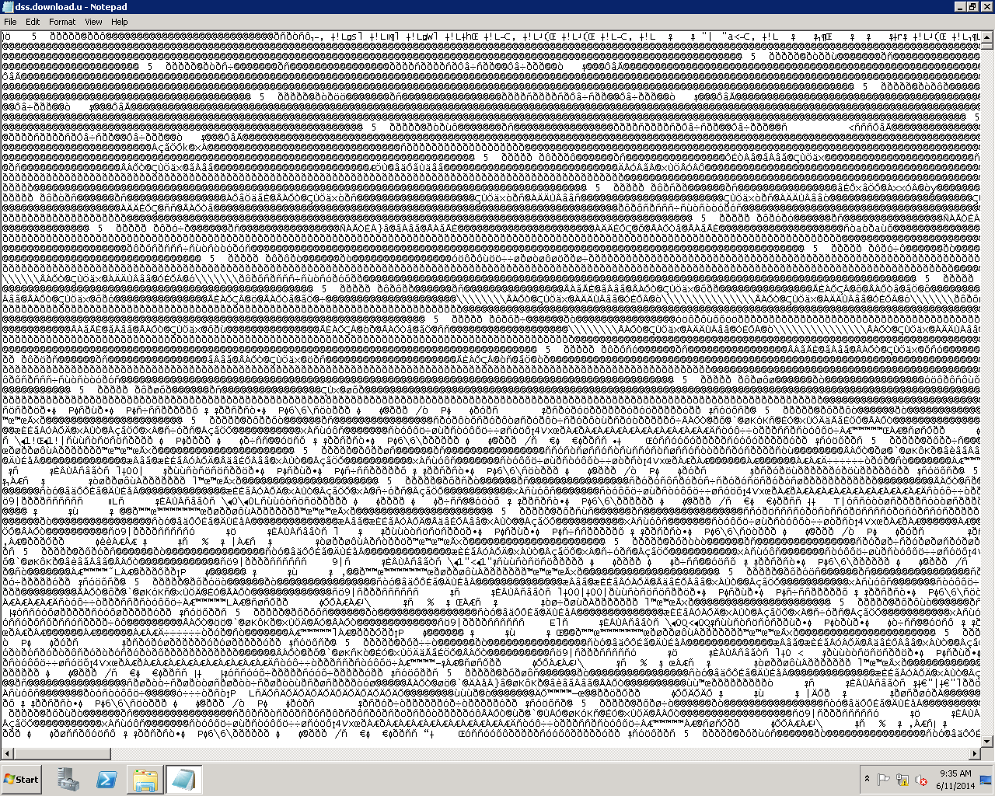
A Notepad View of EBCDIC (this is how it should look)

Slide 13
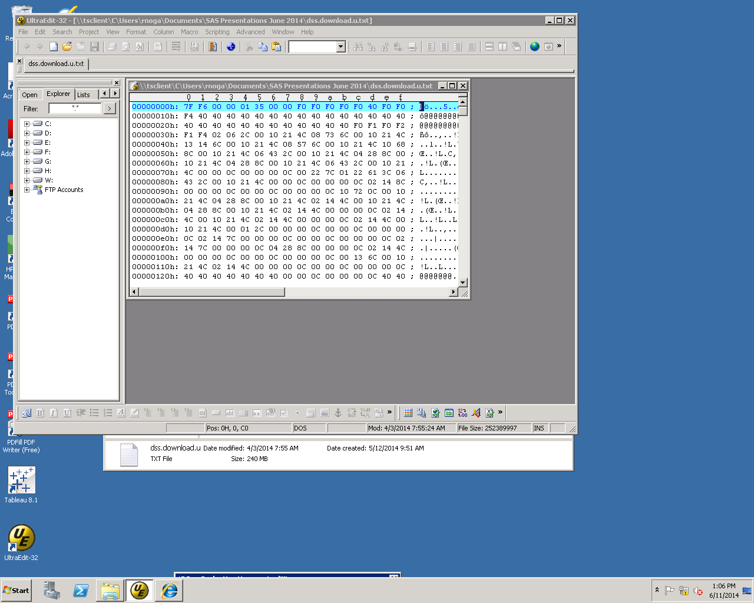
A UltraEdit View of EBCDIC (this is how it should look)

Slide 14
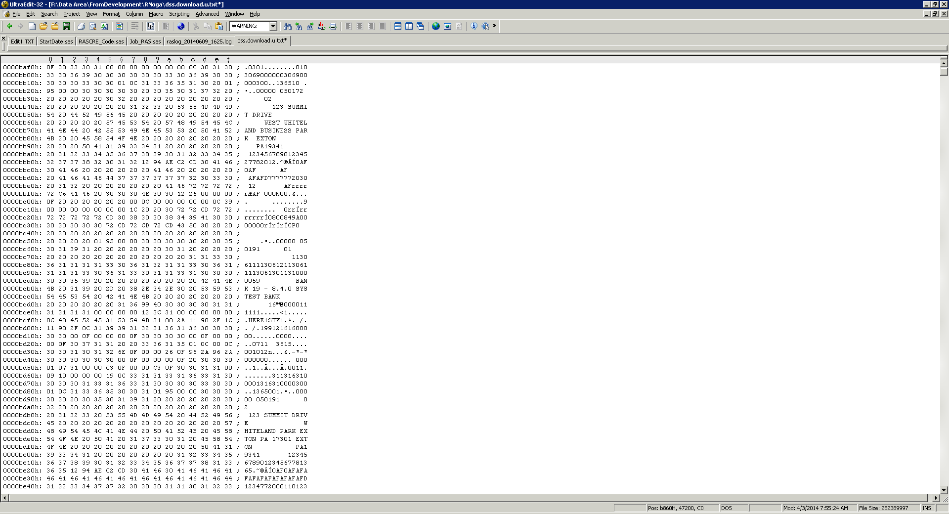
A UltraEdit View of ASCII (this is how it should look)

Slide 15
SAS Input Statement Informats – S370 and EBCDIC
INPUT
@ 19 APPL_CODE S370FZD1.0 /* APPLICATION CODE */
@ 35 PROCTYP1 S370FZD2.0 /* PROCESS TYPE 1 DBID=FC038,MC038 */
@ 35 TYP1DIGIT2 S370FZD1.0 /* PROC TYP1 DIGIT 2 */
@ 36 BOOKENTR S370FZD1.0 /* CBPRC1B */
@ 37 PROCTYP2 S370FZD2.0 /* PROCESS TYPE 2 */
@ 37 TYP2DIGIT1 S370FZD1.0 /* PROC TYP2 DIGIT 1 */
@ 38 TYP2DIGIT2 S370FZD1.0 /* PROC TYP2 DIGIT 2 */
@ 39 DELAVAIL $EBCDIC1.0 /* CBINCTN DBID=FC039,MC039 */
@ 40 NAME $EBCDIC15.0 /* SHORT NAME DBID=FC040,MC040 */
@ 61 OBL_TYPE S370FPD2.0 /* OBLIGATION TYPE DBID=FC043,MC043 */
@ 63 EFFECTDX S370FPD4.0 /* EFFECTIVE DATE DBID=FC044,MC044 */
@ 67 POSTEDDX S370FPD4.0 /* POSTED DATE DBID=FC045,MC045 */
@ 71 LSTCHGDX S370FPD4.0 /* LAST CHANGE DATE DBID=FC046,MC046 */
@ 75 LSTACTDX S370FPD4.0 /* LAST ACTIVE DATE DBID=FC047,MC047 */
@ 79 LGLMATDX S370FPD4.0 /* LEGAL MATURITY DATE DBID=FC048,MC048 */
@ 83 ESTMATDX S370FPD4.0 /* ESTIMATED MATURE DATE DBID=FC049,MC049 */
@ 87 OUTDBTDX S370FPD4.0 /* DATE OUT OF DEBT DBID=FC050,MC050 */
@ 99 ORIGPRIN S370FPD8.2 /* ORIGINAL PRINCIPAL BAL DBID=FC060,MCO6O */
@ 107 CURRPRIN S370FPD8.2 /* CURRENT OUTSTANDING BAL DBID=FC061,MC061 */
@ 115 MCUMMBAL S370FPD8.2 /* MONTHLY CUMMLATIVE BAL DBID=FC062,MC062 */
@ 131 PUEARN S370FPD8.2 /* PLUS UNEARNED DBID=FC064,MC064 */
@ 147 CHOFFBAL S370FPD8.2 /* CHARGE OFF BALANCE DBID=FC066,MC066 */
@ 155 CHOFREOP $EBCDIC1.0 /* CHARGE OFF RECOVERY OPT DBID=FC067,MC067 */
@ 163 ORIGOBLN S370FPD8.2 /* ORIGINAL OBLIGATION AMT DBID=FC070,MC070 */
@ 171 ORGOBLDX S370FPD4.0 /* ORIG OBLIGATION DATE DBID=FC071,MC071 */
@ 183 ORGMATDX S370FPD4.0 /* ORIGINAL MATURITY DATE DBID=FC073,MC073 */
@ 187 RENEWTY $EBCDIC1.0 /* RENEWAL TYPE DBID=FC075,MC075 */
@ 188 RNEWPRNO S370FPD6.0 /* RENEWAL PREVIOUS NUMBER DBID=FC076,MC076 */
@ 194 RNEWTONO S370FPD6.0 /* RENEWAL TO NUMBER DBID=FC077,MC077 */
@ 200 RNEWTIMZ S370FPD2.0 /* RENEWAL NUMBER OF TIMES DBID=FC078,MC078 */
@ 202 SERVUNIT S370FZD5.0 /* SERVICE UNIT DBID=FC080,MC080 */
@ 207 ASSIGNUN S370FZD5.0 /* ASSIGNMENT UNIT NUMBER DBID=FC081,MC081 */
@ 207 ASSIGNUX $EBCDIC5.0 /* ASSIGNMENT UNIT CHAR DBID=FC081,MC081 */
@ 212 OFFICER $EBCDIC5.0 /* OFFICER NUMBER DBID=FC082,MC082 */
@ 217 GEN_LEDG S370FZD7.0 /* GENERAL LEDGER NUMBER DBID=FC083,MC083 */

Slide 16
Special Thanks go to…the real brains behind it all!!!!
David Horvath PNC (Inspiration)
George Scura
Bernie Mckee
Rick Aster
(I’m told Mr. Rick gets all the credit)
Randy Grace
Lisa Cotter
Mike Semple

Slide 17
Upcoming PhilaSUG Meetings
Save the Dates
PRA International Fall 2014
M&T Bank Winter 2015
Drexel University Spring 2015

Slide 18
Thank You for Joining Us Today
A copy of this presentation will be made available on he PhilaSUG website by the end of next week.
Questions?
Randy Noga
484-875-1534
rnoga@afsvision.com

