Slide 1

Creating Sophisticated Graphics using Graph Template Language (GTL)
Kaitlyn McConville, Rho®, Inc.
Kristen Much, Rho®, Inc.
PharmaSUG 2015
Paper #DV02
Notes:
Hello everyone! I am Kristen Much, and today, along with my coworker, Kati McConville, are going to present to you. We both work as statisticians at Rho, a small CRO located in Chapel Hill, North Carolina. The focus of our presentation will be using graph template language to create graphs. Kati and I both found ourselves needing to create highly customized graphs for clients (especially during the manuscript process) that couldn’t be accomplished within the SGPLOT/SGPANEL procedures, and stumbled upon the very powerful capabilities of graph template language. This presentation will describe the basic tools you need to create a graph with graph template language as well as explore three specific examples of graphs developed by us for manuscript publication.

Slide 2
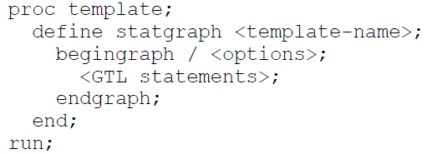
GTL Overview
Step 1
Step 2

Slide 3

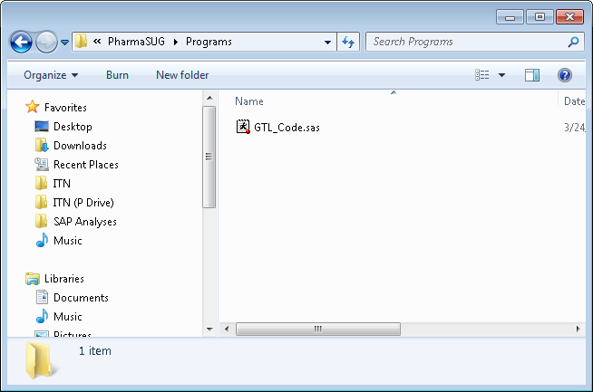
Shortcut!
TMPLOUT

Slide 4
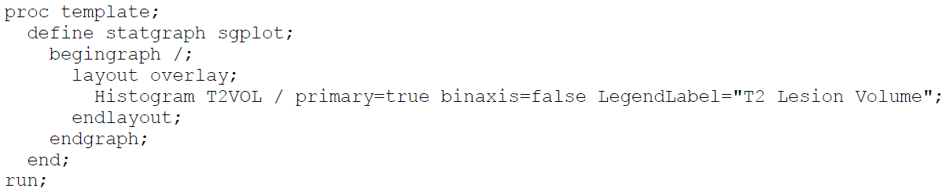
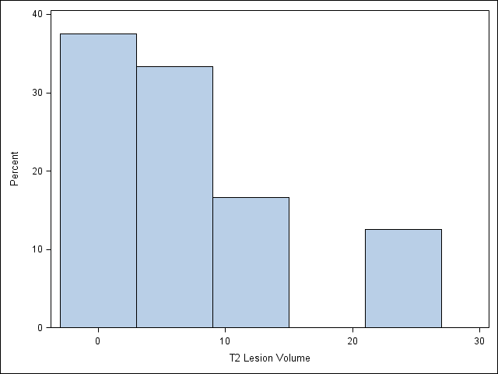
GTL_Code.sas

Slide 5
Example 1
Scatter Plot Overlaid on Box Plot
5
Notes:
The first example we are going to show you today walks through scatter plots overlaid on boxplots over time (for 5 visits) by two different treatment groups. In fact, this is the graph that GTL will enable us to create.

Slide 6
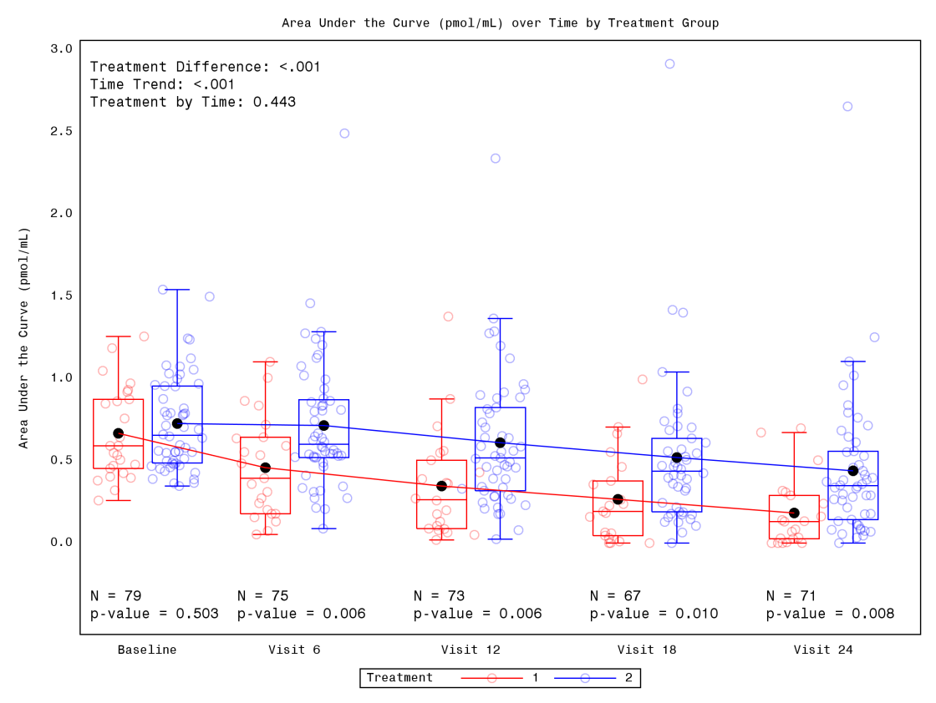
Notes:
Summarize.

Slide 7
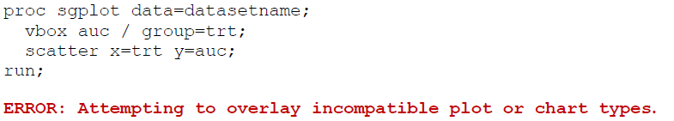
The Motivation
7
Notes:
If you were to attempt to produce the graph I just showed you using SGPLOT, the following error would appear. In short, SAS categorizes each type of plot that you can create within the SGPLOT procedure and not all of the plot types cannot be used together in the same SGPLOT step—boxplot (distribution) and scatter plot (basic) being one of incompatible types. Since I was not able to produce what I wanted within SGPLOT, I had to search elsewhere. This led me to GTL.

Slide 8
The Code
proc template;
define statgraph scatterbox;
begingraph;
entrytitle "Area Under the Curve (pmol/mL) over Time by Treatment Group";
layout overlay / xaxisopts=(<OPTIONS1>) yaxisopts=(<OPTIONS2>);
drawtext textattrs=(size=8pt) "Treatment Difference: &treat_auc." /<OPTIONS3>;
drawtext textattrs=(size=8pt) "Time Trend: &time_auc." / <OPTIONS4>;
drawtext textattrs=(size=8pt) "Treatment by Time: &trtbtime_auc." /<OPTIONS5>;
drawtext textattrs=(size=8pt) "N = &n0_auc." / <OPTIONS6>;
drawtext textattrs=(size=8pt) "p-value = &p0_auc." / <OPTIONS7>;
drawtext textattrs=(size=8pt) "N = &n6_auc." / <OPTIONS8>;
drawtext textattrs=(size=8pt) "p-value = &p6_auc." / <OPTIONS9>;;
drawtext textattrs=(size=8pt) "N = &n12_auc." / <OPTIONS10>;
drawtext textattrs=(size=8pt) "p-value = &p12_auc." / <OPTIONS11>;
drawtext textattrs=(size=8pt) "N = &n18_auc." / <OPTIONS12>;
drawtext textattrs=(size=8pt) "p-value = &p18_auc." / <OPTIONS13>;
drawtext textattrs=(size=8pt) "N = &n24_auc." / <OPTIONS14>;
drawtext textattrs=(size=8pt) "p-value = &p24_auc." / <OPTIONS15>;
scatterplot x=eval(0.4*rannor(57)+visitn2) y=auc / group=trt name="trt1" <OPTIONS16>;
boxplot x=visitn2 y=auc / group=trt display=(caps mean median connect) connect=mean name="trt2";
mergedlegend "trt1" "trt2" / title="Treatment";
endlayout;
endgraph;
end;
run;
proc sgrender data=datasetname template=scatterbox;
run;
8
Notes:
So here is the corresponding code that produces the scatter plots overlaid on box plots. Just like we talked about in the intro, we have the standard code that must always be used (define template, begin/end graph). The first piece of the code I want to highlight is the LAYOUT OVERLAY. This enabled me to overlay the scatter plots on the box plots. To randomly scatter the points along the x-axis I used the EVAL function. This is specific to GTL and instead of having to created a new x-variable in a separate dataset step, I could just use the EVAL function. The function randomly jitters each point along the x-axis using RANNOR to add a random value from the normal distribution. The multiplier of 0.4 is used to control the width of the jittering so the points stay within the width of the boxplot. The DRAWTEXT statements allow me to annotate without the use of an annotate dataset! Since the text to be drawn could change as the data change, annotation was done with predefined macro variables. The MERGELEGEND statement allows for both identifiers of each plot statement to be displayed.

Slide 9
The Code
proc template;
define statgraph scatterbox;
begingraph;
entrytitle "Area Under the Curve (pmol/mL) over Time by Treatment Group";
layout overlay / xaxisopts=(<OPTIONS1>) yaxisopts=(<OPTIONS2>);
drawtext textattrs=(size=8pt) "Treatment Difference: &treat_auc." /<OPTIONS3>;
drawtext textattrs=(size=8pt) "Time Trend: &time_auc." / <OPTIONS4>;
drawtext textattrs=(size=8pt) "Treatment by Time: &trtbtime_auc." /<OPTIONS5>;
drawtext textattrs=(size=8pt) "N = &n0_auc." / <OPTIONS6>;
drawtext textattrs=(size=8pt) "p-value = &p0_auc." / <OPTIONS7>;
drawtext textattrs=(size=8pt) "N = &n6_auc." / <OPTIONS8>;
drawtext textattrs=(size=8pt) "p-value = &p6_auc." / <OPTIONS9>;;
drawtext textattrs=(size=8pt) "N = &n12_auc." / <OPTIONS10>;
drawtext textattrs=(size=8pt) "p-value = &p12_auc." / <OPTIONS11>;
drawtext textattrs=(size=8pt) "N = &n18_auc." / <OPTIONS12>;
drawtext textattrs=(size=8pt) "p-value = &p18_auc." / <OPTIONS13>;
drawtext textattrs=(size=8pt) "N = &n24_auc." / <OPTIONS14>;
drawtext textattrs=(size=8pt) "p-value = &p24_auc." / <OPTIONS15>;
scatterplot x=eval(0.4*rannor(57)+visitn2) y=auc / group=trt name="trt1" <OPTIONS16>;
boxplot x=visitn2 y=auc / group=trt display=(caps mean median connect) connect=mean name="trt2";
mergedlegend "trt1" "trt2" / title="Treatment";
endlayout;
endgraph;
end;
run;
proc sgrender data=datasetname template=scatterbox;
run;
9
Notes:
So here is the corresponding code that produces the scatter plots overlaid on box plots. Just like we talked about in the intro, we have the standard code that must always be used (define template, begin/end graph). The first piece of the code I want to highlight is the LAYOUT OVERLAY. This enabled me to overlay the scatter plots on the box plots. To randomly scatter the points along the x-axis I used the EVAL function. This is specific to GTL and instead of having to created a new x-variable in a separate dataset step, I could just use the EVAL function. The function randomly jitters each point along the x-axis using RANNOR to add a random value from the normal distribution. The multiplier of 0.4 is used to control the width of the jittering so the points stay within the width of the boxplot. The DRAWTEXT statements allow me to annotate without the use of an annotate dataset! Since the text to be drawn could change as the data change, annotation was done with predefined macro variables. The MERGELEGEND statement allows for both identifiers of each plot statement to be displayed.

Slide 10
The Code
proc template;
define statgraph scatterbox;
begingraph;
entrytitle "Area Under the Curve (pmol/mL) over Time by Treatment Group";
layout overlay / xaxisopts=(<OPTIONS1>) yaxisopts=(<OPTIONS2>);
drawtext textattrs=(size=8pt) "Treatment Difference: &treat_auc." /<OPTIONS3>;
drawtext textattrs=(size=8pt) "Time Trend: &time_auc." / <OPTIONS4>;
drawtext textattrs=(size=8pt) "Treatment by Time: &trtbtime_auc." /<OPTIONS5>;
drawtext textattrs=(size=8pt) "N = &n0_auc." / <OPTIONS6>;
drawtext textattrs=(size=8pt) "p-value = &p0_auc." / <OPTIONS7>;
drawtext textattrs=(size=8pt) "N = &n6_auc." / <OPTIONS8>;
drawtext textattrs=(size=8pt) "p-value = &p6_auc." / <OPTIONS9>;;
drawtext textattrs=(size=8pt) "N = &n12_auc." / <OPTIONS10>;
drawtext textattrs=(size=8pt) "p-value = &p12_auc." / <OPTIONS11>;
drawtext textattrs=(size=8pt) "N = &n18_auc." / <OPTIONS12>;
drawtext textattrs=(size=8pt) "p-value = &p18_auc." / <OPTIONS13>;
drawtext textattrs=(size=8pt) "N = &n24_auc." / <OPTIONS14>;
drawtext textattrs=(size=8pt) "p-value = &p24_auc." / <OPTIONS15>;
scatterplot x=eval(0.4*rannor(57)+visitn2) y=auc / group=trt name="trt1" <OPTIONS16>;
boxplot x=visitn2 y=auc / group=trt display=(caps mean median connect) connect=mean name="trt2";
mergedlegend "trt1" "trt2" / title="Treatment";
endlayout;
endgraph;
end;
run;
proc sgrender data=datasetname template=scatterbox;
run;
10
Notes:
So here is the corresponding code that produces the scatter plots overlaid on box plots. Just like we talked about in the intro, we have the standard code that must always be used (define template, begin/end graph). The first piece of the code I want to highlight is the LAYOUT OVERLAY. This enabled me to overlay the scatter plots on the box plots. To randomly scatter the points along the x-axis I used the EVAL function. This is specific to GTL and instead of having to created a new x-variable in a separate dataset step, I could just use the EVAL function. The function randomly jitters each point along the x-axis using RANNOR to add a random value from the normal distribution. The multiplier of 0.4 is used to control the width of the jittering so the points stay within the width of the boxplot. The DRAWTEXT statements allow me to annotate without the use of an annotate dataset! Since the text to be drawn could change as the data change, annotation was done with predefined macro variables. The MERGELEGEND statement allows for both identifiers of each plot statement to be displayed.

Slide 11
Notes:
Summarize.

Slide 12
The Code
proc template;
define statgraph scatterbox;
begingraph;
entrytitle "Area Under the Curve (pmol/mL) over Time by Treatment Group";
layout overlay / xaxisopts=(<OPTIONS1>) yaxisopts=(<OPTIONS2>);
drawtext textattrs=(size=8pt) "Treatment Difference: &treat_auc." /<OPTIONS3>;
drawtext textattrs=(size=8pt) "Time Trend: &time_auc." / <OPTIONS4>;
drawtext textattrs=(size=8pt) "Treatment by Time: &trtbtime_auc." /<OPTIONS5>;
drawtext textattrs=(size=8pt) "N = &n0_auc." / <OPTIONS6>;
drawtext textattrs=(size=8pt) "p-value = &p0_auc." / <OPTIONS7>;
drawtext textattrs=(size=8pt) "N = &n6_auc." / <OPTIONS8>;
drawtext textattrs=(size=8pt) "p-value = &p6_auc." / <OPTIONS9>;;
drawtext textattrs=(size=8pt) "N = &n12_auc." / <OPTIONS10>;
drawtext textattrs=(size=8pt) "p-value = &p12_auc." / <OPTIONS11>;
drawtext textattrs=(size=8pt) "N = &n18_auc." / <OPTIONS12>;
drawtext textattrs=(size=8pt) "p-value = &p18_auc." / <OPTIONS13>;
drawtext textattrs=(size=8pt) "N = &n24_auc." / <OPTIONS14>;
drawtext textattrs=(size=8pt) "p-value = &p24_auc." / <OPTIONS15>;
scatterplot x=eval(0.4*rannor(57)+visitn2) y=auc / group=trt name="trt1" <OPTIONS16>;
boxplot x=visitn2 y=auc / group=trt display=(caps mean median connect) connect=mean name="trt2";
mergedlegend "trt1" "trt2" / title="Treatment";
endlayout;
endgraph;
end;
run;
proc sgrender data=datasetname template=scatterbox;
run;
12
Notes:
So here is the corresponding code that produces the scatter plots overlaid on box plots. Just like we talked about in the intro, we have the standard code that must always be used (define template, begin/end graph). The first piece of the code I want to highlight is the LAYOUT OVERLAY. This enabled me to overlay the scatter plots on the box plots. To randomly scatter the points along the x-axis I used the EVAL function. This is specific to GTL and instead of having to created a new x-variable in a separate dataset step, I could just use the EVAL function. The function randomly jitters each point along the x-axis using RANNOR to add a random value from the normal distribution. The multiplier of 0.4 is used to control the width of the jittering so the points stay within the width of the boxplot. The DRAWTEXT statements allow me to annotate without the use of an annotate dataset! Since the text to be drawn could change as the data change, annotation was done with predefined macro variables. The MERGELEGEND statement allows for both identifiers of each plot statement to be displayed.

Slide 13
Notes:
Summarize.

Slide 14
The Code
proc template;
define statgraph scatterbox;
begingraph;
entrytitle "Area Under the Curve (pmol/mL) over Time by Treatment Group";
layout overlay / xaxisopts=(<OPTIONS1>) yaxisopts=(<OPTIONS2>);
drawtext textattrs=(size=8pt) "Treatment Difference: &treat_auc." /<OPTIONS3>;
drawtext textattrs=(size=8pt) "Time Trend: &time_auc." / <OPTIONS4>;
drawtext textattrs=(size=8pt) "Treatment by Time: &trtbtime_auc." /<OPTIONS5>;
drawtext textattrs=(size=8pt) "N = &n0_auc." / <OPTIONS6>;
drawtext textattrs=(size=8pt) "p-value = &p0_auc." / <OPTIONS7>;
drawtext textattrs=(size=8pt) "N = &n6_auc." / <OPTIONS8>;
drawtext textattrs=(size=8pt) "p-value = &p6_auc." / <OPTIONS9>;;
drawtext textattrs=(size=8pt) "N = &n12_auc." / <OPTIONS10>;
drawtext textattrs=(size=8pt) "p-value = &p12_auc." / <OPTIONS11>;
drawtext textattrs=(size=8pt) "N = &n18_auc." / <OPTIONS12>;
drawtext textattrs=(size=8pt) "p-value = &p18_auc." / <OPTIONS13>;
drawtext textattrs=(size=8pt) "N = &n24_auc." / <OPTIONS14>;
drawtext textattrs=(size=8pt) "p-value = &p24_auc." / <OPTIONS15>;
scatterplot x=eval(0.4*rannor(57)+visitn2) y=auc / group=trt name="trt1" <OPTIONS16>;
boxplot x=visitn2 y=auc / group=trt display=(caps mean median connect) connect=mean name="trt2";
mergedlegend "trt1" "trt2" / title="Treatment";
endlayout;
endgraph;
end;
run;
proc sgrender data=datasetname template=scatterbox;
run;
14
Notes:
So here is the corresponding code that produces the scatter plots overlaid on box plots. Just like we talked about in the intro, we have the standard code that must always be used (define template, begin/end graph). The first piece of the code I want to highlight is the LAYOUT OVERLAY. This enabled me to overlay the scatter plots on the box plots. To randomly scatter the points along the x-axis I used the EVAL function. This is specific to GTL and instead of having to created a new x-variable in a separate dataset step, I could just use the EVAL function. The function randomly jitters each point along the x-axis using RANNOR to add a random value from the normal distribution. The multiplier of 0.4 is used to control the width of the jittering so the points stay within the width of the boxplot. The DRAWTEXT statements allow me to annotate without the use of an annotate dataset! Since the text to be drawn could change as the data change, annotation was done with predefined macro variables. The MERGELEGEND statement allows for both identifiers of each plot statement to be displayed.

Slide 15
Notes:
Summarize.

Slide 16
The Code
proc template;
define statgraph scatterbox;
begingraph;
entrytitle "Area Under the Curve (pmol/mL) over Time by Treatment Group";
layout overlay / xaxisopts=(<OPTIONS1>) yaxisopts=(<OPTIONS2>);
drawtext textattrs=(size=8pt) "Treatment Difference: &treat_auc." /<OPTIONS3>;
drawtext textattrs=(size=8pt) "Time Trend: &time_auc." / <OPTIONS4>;
drawtext textattrs=(size=8pt) "Treatment by Time: &trtbtime_auc." /<OPTIONS5>;
drawtext textattrs=(size=8pt) "N = &n0_auc." / <OPTIONS6>;
drawtext textattrs=(size=8pt) "p-value = &p0_auc." / <OPTIONS7>;
drawtext textattrs=(size=8pt) "N = &n6_auc." / <OPTIONS8>;
drawtext textattrs=(size=8pt) "p-value = &p6_auc." / <OPTIONS9>;;
drawtext textattrs=(size=8pt) "N = &n12_auc." / <OPTIONS10>;
drawtext textattrs=(size=8pt) "p-value = &p12_auc." / <OPTIONS11>;
drawtext textattrs=(size=8pt) "N = &n18_auc." / <OPTIONS12>;
drawtext textattrs=(size=8pt) "p-value = &p18_auc." / <OPTIONS13>;
drawtext textattrs=(size=8pt) "N = &n24_auc." / <OPTIONS14>;
drawtext textattrs=(size=8pt) "p-value = &p24_auc." / <OPTIONS15>;
scatterplot x=eval(0.4*rannor(57)+visitn2) y=auc / group=trt name="trt1" <OPTIONS16>;
boxplot x=visitn2 y=auc / group=trt display=(caps mean median connect) connect=mean name="trt2";
mergedlegend "trt1" "trt2" / title="Treatment";
endlayout;
endgraph;
end;
run;
proc sgrender data=datasetname template=scatterbox;
run;
16
Notes:
So here is the corresponding code that produces the scatter plots overlaid on box plots. Just like we talked about in the intro, we have the standard code that must always be used (define template, begin/end graph). The first piece of the code I want to highlight is the LAYOUT OVERLAY. This enabled me to overlay the scatter plots on the box plots. To randomly scatter the points along the x-axis I used the EVAL function. This is specific to GTL and instead of having to created a new x-variable in a separate dataset step, I could just use the EVAL function. The function randomly jitters each point along the x-axis using RANNOR to add a random value from the normal distribution. The multiplier of 0.4 is used to control the width of the jittering so the points stay within the width of the boxplot. The DRAWTEXT statements allow me to annotate without the use of an annotate dataset! Since the text to be drawn could change as the data change, annotation was done with predefined macro variables. The MERGELEGEND statement allows for both identifiers of each plot statement to be displayed.

Slide 17
Notes:
Summarize.

Slide 18
Example 2
Multi-cell Graph with Nested Layout Lattice
18

Slide 20
The Code
proc template;
define statgraph mri;
begingraph;
entrytitle 'Baseline MRI Characteristics';
layout lattice /rows=1 columns=2 columnweights=(0.6 0.4) columngutter=.5cm;
layout overlay / yaxisopts=(griddisplay=on);
histogram t2vol / binaxis=false;
densityplot t2vol / lineattrs=graphfit name='density' legendlabel=’Normal’;
discretelegend 'density' / location=inside halign=left valign=top;
layout gridded / rows=5 columns=2 opaque=true border=true autoalign=(topright);
entry halign=left 'Mean'; entry halign=right "&mean";
entry halign=left 'Std.Dev'; entry halign=right "&std";
entry halign=left 'Median'; entry halign=right "&med";
entry halign=left 'Min'; entry halign=right "&min";
entry halign=left 'Max'; entry halign=right "&max";
endlayout;
endlayout;
layout lattice / rows=2 columns=1 rowgutter=.5cm;
layout overlay / yaxisopts=(griddisplay=on linearopts=(tickvaluelist=(0 3 6 9 12 15)));
barchart x=gadc;
endlayout;
layout overlay / xaxisopts=(linearopts=(viewmax=4));
scatterplot x=t1vol y=t2vol;
endlayout;
endlayout;
endlayout;
endgraph;
end;
run;
proc sgrender data=datasetname template=mri;
run;
20
Notes:
So here is the corresponding code that produces the scatter plots overlaid on box plots. Just like we talked about in the intro, we have the standard code that must always be used (define template, begin/end graph). The first piece of the code I want to highlight is the LAYOUT OVERLAY. This enabled me to overlay the scatter plots on the box plots. To randomly scatter the points along the x-axis I used the EVAL function. This is specific to GTL and instead of having to created a new x-variable in a separate dataset step, I could just use the EVAL function. The function randomly jitters each point along the x-axis using RANNOR to add a random value from the normal distribution. The multiplier of 0.4 is used to control the width of the jittering so the points stay within the width of the boxplot. The DRAWTEXT statements allow me to annotate without the use of an annotate dataset! Since the text to be drawn could change as the data change, annotation was done with predefined macro variables. The MERGELEGEND statement allows for both identifiers of each plot statement to be displayed.

Slide 21
The Code
proc template;
define statgraph mri;
begingraph;
entrytitle 'Baseline MRI Characteristics';
layout lattice /rows=1 columns=2 columnweights=(0.6 0.4) columngutter=.5cm;
layout overlay / yaxisopts=(griddisplay=on);
histogram t2vol / binaxis=false;
densityplot t2vol / lineattrs=graphfit name='density' legendlabel=’Normal’;
discretelegend 'density' / location=inside halign=left valign=top;
layout gridded / rows=5 columns=2 opaque=true border=true autoalign=(topright);
entry halign=left 'Mean'; entry halign=right "&mean";
entry halign=left 'Std.Dev'; entry halign=right "&std";
entry halign=left 'Median'; entry halign=right "&med";
entry halign=left 'Min'; entry halign=right "&min";
entry halign=left 'Max'; entry halign=right "&max";
endlayout;
endlayout;
layout lattice / rows=2 columns=1 rowgutter=.5cm;
layout overlay / yaxisopts=(griddisplay=on linearopts=(tickvaluelist=(0 3 6 9 12 15)));
barchart x=gadc;
endlayout;
layout overlay / xaxisopts=(linearopts=(viewmax=4));
scatterplot x=t1vol y=t2vol;
endlayout;
endlayout;
endlayout;
endgraph;
end;
run;
proc sgrender data=datasetname template=mri;
run;
21
Notes:
So here is the corresponding code that produces the scatter plots overlaid on box plots. Just like we talked about in the intro, we have the standard code that must always be used (define template, begin/end graph). The first piece of the code I want to highlight is the LAYOUT OVERLAY. This enabled me to overlay the scatter plots on the box plots. To randomly scatter the points along the x-axis I used the EVAL function. This is specific to GTL and instead of having to created a new x-variable in a separate dataset step, I could just use the EVAL function. The function randomly jitters each point along the x-axis using RANNOR to add a random value from the normal distribution. The multiplier of 0.4 is used to control the width of the jittering so the points stay within the width of the boxplot. The DRAWTEXT statements allow me to annotate without the use of an annotate dataset! Since the text to be drawn could change as the data change, annotation was done with predefined macro variables. The MERGELEGEND statement allows for both identifiers of each plot statement to be displayed.

Slide 22
The Code
proc template;
define statgraph mri;
begingraph;
entrytitle 'Baseline MRI Characteristics';
layout lattice /rows=1 columns=2 columnweights=(0.6 0.4) columngutter=.5cm;
layout overlay / yaxisopts=(griddisplay=on);
histogram t2vol / binaxis=false;
densityplot t2vol / lineattrs=graphfit name='density' legendlabel=’Normal’;
discretelegend 'density' / location=inside halign=left valign=top;
layout gridded / rows=5 columns=2 opaque=true border=true autoalign=(topright);
entry halign=left 'Mean'; entry halign=right "&mean";
entry halign=left 'Std.Dev'; entry halign=right "&std";
entry halign=left 'Median'; entry halign=right "&med";
entry halign=left 'Min'; entry halign=right "&min";
entry halign=left 'Max'; entry halign=right "&max";
endlayout;
endlayout;
layout lattice / rows=2 columns=1 rowgutter=.5cm;
layout overlay / yaxisopts=(griddisplay=on linearopts=(tickvaluelist=(0 3 6 9 12 15)));
barchart x=gadc;
endlayout;
layout overlay / xaxisopts=(linearopts=(viewmax=4));
scatterplot x=t1vol y=t2vol;
endlayout;
endlayout;
endlayout;
endgraph;
end;
run;
proc sgrender data=datasetname template=mri;
run;
22
Notes:
So here is the corresponding code that produces the scatter plots overlaid on box plots. Just like we talked about in the intro, we have the standard code that must always be used (define template, begin/end graph). The first piece of the code I want to highlight is the LAYOUT OVERLAY. This enabled me to overlay the scatter plots on the box plots. To randomly scatter the points along the x-axis I used the EVAL function. This is specific to GTL and instead of having to created a new x-variable in a separate dataset step, I could just use the EVAL function. The function randomly jitters each point along the x-axis using RANNOR to add a random value from the normal distribution. The multiplier of 0.4 is used to control the width of the jittering so the points stay within the width of the boxplot. The DRAWTEXT statements allow me to annotate without the use of an annotate dataset! Since the text to be drawn could change as the data change, annotation was done with predefined macro variables. The MERGELEGEND statement allows for both identifiers of each plot statement to be displayed.

Slide 24
The Code
proc template;
define statgraph mri;
begingraph;
entrytitle 'Baseline MRI Characteristics';
layout lattice /rows=1 columns=2 columnweights=(0.6 0.4) columngutter=.5cm;
layout overlay / yaxisopts=(griddisplay=on);
histogram t2vol / binaxis=false;
densityplot t2vol / lineattrs=graphfit name='density' legendlabel=’Normal’;
discretelegend 'density' / location=inside halign=left valign=top;
layout gridded / rows=5 columns=2 opaque=true border=true autoalign=(topright);
entry halign=left 'Mean'; entry halign=right "&mean";
entry halign=left 'Std.Dev'; entry halign=right "&std";
entry halign=left 'Median'; entry halign=right "&med";
entry halign=left 'Min'; entry halign=right "&min";
entry halign=left 'Max'; entry halign=right "&max";
endlayout;
endlayout;
layout lattice / rows=2 columns=1 rowgutter=.5cm;
layout overlay / yaxisopts=(griddisplay=on linearopts=(tickvaluelist=(0 3 6 9 12 15)));
barchart x=gadc;
endlayout;
layout overlay / xaxisopts=(linearopts=(viewmax=4));
scatterplot x=t1vol y=t2vol;
endlayout;
endlayout;
endlayout;
endgraph;
end;
run;
proc sgrender data=datasetname template=mri;
run;
24
Notes:
So here is the corresponding code that produces the scatter plots overlaid on box plots. Just like we talked about in the intro, we have the standard code that must always be used (define template, begin/end graph). The first piece of the code I want to highlight is the LAYOUT OVERLAY. This enabled me to overlay the scatter plots on the box plots. To randomly scatter the points along the x-axis I used the EVAL function. This is specific to GTL and instead of having to created a new x-variable in a separate dataset step, I could just use the EVAL function. The function randomly jitters each point along the x-axis using RANNOR to add a random value from the normal distribution. The multiplier of 0.4 is used to control the width of the jittering so the points stay within the width of the boxplot. The DRAWTEXT statements allow me to annotate without the use of an annotate dataset! Since the text to be drawn could change as the data change, annotation was done with predefined macro variables. The MERGELEGEND statement allows for both identifiers of each plot statement to be displayed.

Slide 26
The Code
proc template;
define statgraph mri;
begingraph;
entrytitle 'Baseline MRI Characteristics';
layout lattice /rows=1 columns=2 columnweights=(0.6 0.4) columngutter=.5cm;
layout overlay / yaxisopts=(griddisplay=on);
histogram t2vol / binaxis=false;
densityplot t2vol / lineattrs=graphfit name='density' legendlabel=’Normal’;
discretelegend 'density' / location=inside halign=left valign=top;
layout gridded / rows=5 columns=2 opaque=true border=true autoalign=(topright);
entry halign=left 'Mean'; entry halign=right "&mean";
entry halign=left 'Std.Dev'; entry halign=right "&std";
entry halign=left 'Median'; entry halign=right "&med";
entry halign=left 'Min'; entry halign=right "&min";
entry halign=left 'Max'; entry halign=right "&max";
endlayout;
endlayout;
layout lattice / rows=2 columns=1 rowgutter=.5cm;
layout overlay / yaxisopts=(griddisplay=on linearopts=(tickvaluelist=(0 3 6 9 12 15)));
barchart x=gadc;
endlayout;
layout overlay / xaxisopts=(linearopts=(viewmax=4));
scatterplot x=t1vol y=t2vol;
endlayout;
endlayout;
endlayout;
endgraph;
end;
run;
proc sgrender data=datasetname template=mri;
run;
26
Notes:
So here is the corresponding code that produces the scatter plots overlaid on box plots. Just like we talked about in the intro, we have the standard code that must always be used (define template, begin/end graph). The first piece of the code I want to highlight is the LAYOUT OVERLAY. This enabled me to overlay the scatter plots on the box plots. To randomly scatter the points along the x-axis I used the EVAL function. This is specific to GTL and instead of having to created a new x-variable in a separate dataset step, I could just use the EVAL function. The function randomly jitters each point along the x-axis using RANNOR to add a random value from the normal distribution. The multiplier of 0.4 is used to control the width of the jittering so the points stay within the width of the boxplot. The DRAWTEXT statements allow me to annotate without the use of an annotate dataset! Since the text to be drawn could change as the data change, annotation was done with predefined macro variables. The MERGELEGEND statement allows for both identifiers of each plot statement to be displayed.

Slide 27
The Code
proc template;
define statgraph mri;
begingraph;
entrytitle 'Baseline MRI Characteristics';
layout lattice /rows=1 columns=2 columnweights=(0.6 0.4) columngutter=.5cm;
layout overlay / yaxisopts=(griddisplay=on);
histogram t2vol / binaxis=false;
densityplot t2vol / lineattrs=graphfit name='density' legendlabel=’Normal’;
discretelegend 'density' / location=inside halign=left valign=top;
layout gridded / rows=5 columns=2 opaque=true border=true autoalign=(topright);
entry halign=left 'Mean'; entry halign=right "&mean";
entry halign=left 'Std.Dev'; entry halign=right "&std";
entry halign=left 'Median'; entry halign=right "&med";
entry halign=left 'Min'; entry halign=right "&min";
entry halign=left 'Max'; entry halign=right "&max";
endlayout;
endlayout;
layout lattice / rows=2 columns=1 rowgutter=.5cm;
layout overlay / yaxisopts=(griddisplay=on linearopts=(tickvaluelist=(0 3 6 9 12 15)));
barchart x=gadc;
endlayout;
layout overlay / xaxisopts=(linearopts=(viewmax=4));
scatterplot x=t1vol y=t2vol;
endlayout;
endlayout;
endlayout;
endgraph;
end;
run;
proc sgrender data=datasetname template=mri;
run;
27
Notes:
So here is the corresponding code that produces the scatter plots overlaid on box plots. Just like we talked about in the intro, we have the standard code that must always be used (define template, begin/end graph). The first piece of the code I want to highlight is the LAYOUT OVERLAY. This enabled me to overlay the scatter plots on the box plots. To randomly scatter the points along the x-axis I used the EVAL function. This is specific to GTL and instead of having to created a new x-variable in a separate dataset step, I could just use the EVAL function. The function randomly jitters each point along the x-axis using RANNOR to add a random value from the normal distribution. The multiplier of 0.4 is used to control the width of the jittering so the points stay within the width of the boxplot. The DRAWTEXT statements allow me to annotate without the use of an annotate dataset! Since the text to be drawn could change as the data change, annotation was done with predefined macro variables. The MERGELEGEND statement allows for both identifiers of each plot statement to be displayed.

Slide 29
The Code
proc template;
define statgraph mri;
begingraph;
entrytitle 'Baseline MRI Characteristics';
layout lattice /rows=1 columns=2 columnweights=(0.6 0.4) columngutter=.5cm;
layout overlay / yaxisopts=(griddisplay=on);
histogram t2vol / binaxis=false;
densityplot t2vol / lineattrs=graphfit name='density' legendlabel=’Normal’;
discretelegend 'density' / location=inside halign=left valign=top;
layout gridded / rows=5 columns=2 opaque=true border=true autoalign=(topright);
entry halign=left 'Mean'; entry halign=right "&mean";
entry halign=left 'Std.Dev'; entry halign=right "&std";
entry halign=left 'Median'; entry halign=right "&med";
entry halign=left 'Min'; entry halign=right "&min";
entry halign=left 'Max'; entry halign=right "&max";
endlayout;
endlayout;
layout lattice / rows=2 columns=1 rowgutter=.5cm;
layout overlay / yaxisopts=(griddisplay=on linearopts=(tickvaluelist=(0 3 6 9 12 15)));
barchart x=gadc;
endlayout;
layout overlay / xaxisopts=(linearopts=(viewmax=4));
scatterplot x=t1vol y=t2vol;
endlayout;
endlayout;
endlayout;
endgraph;
end;
run;
proc sgrender data=datasetname template=mri;
run;
29
Notes:
So here is the corresponding code that produces the scatter plots overlaid on box plots. Just like we talked about in the intro, we have the standard code that must always be used (define template, begin/end graph). The first piece of the code I want to highlight is the LAYOUT OVERLAY. This enabled me to overlay the scatter plots on the box plots. To randomly scatter the points along the x-axis I used the EVAL function. This is specific to GTL and instead of having to created a new x-variable in a separate dataset step, I could just use the EVAL function. The function randomly jitters each point along the x-axis using RANNOR to add a random value from the normal distribution. The multiplier of 0.4 is used to control the width of the jittering so the points stay within the width of the boxplot. The DRAWTEXT statements allow me to annotate without the use of an annotate dataset! Since the text to be drawn could change as the data change, annotation was done with predefined macro variables. The MERGELEGEND statement allows for both identifiers of each plot statement to be displayed.

Slide 30
The Code
proc template;
define statgraph mri;
begingraph;
entrytitle 'Baseline MRI Characteristics';
layout lattice /rows=1 columns=2 columnweights=(0.6 0.4) columngutter=.5cm;
layout overlay / yaxisopts=(griddisplay=on);
histogram t2vol / binaxis=false;
densityplot t2vol / lineattrs=graphfit name='density' legendlabel=’Normal’;
discretelegend 'density' / location=inside halign=left valign=top;
layout gridded / rows=5 columns=2 opaque=true border=true autoalign=(topright);
entry halign=left 'Mean'; entry halign=right "&mean";
entry halign=left 'Std.Dev'; entry halign=right "&std";
entry halign=left 'Median'; entry halign=right "&med";
entry halign=left 'Min'; entry halign=right "&min";
entry halign=left 'Max'; entry halign=right "&max";
endlayout;
endlayout;
layout lattice / rows=2 columns=1 rowgutter=.5cm;
layout overlay / yaxisopts=(griddisplay=on linearopts=(tickvaluelist=(0 3 6 9 12 15)));
barchart x=gadc;
endlayout;
layout overlay / xaxisopts=(linearopts=(viewmax=4));
scatterplot x=t1vol y=t2vol;
endlayout;
endlayout;
endlayout;
endgraph;
end;
run;
proc sgrender data=datasetname template=mri;
run;
30
Notes:
So here is the corresponding code that produces the scatter plots overlaid on box plots. Just like we talked about in the intro, we have the standard code that must always be used (define template, begin/end graph). The first piece of the code I want to highlight is the LAYOUT OVERLAY. This enabled me to overlay the scatter plots on the box plots. To randomly scatter the points along the x-axis I used the EVAL function. This is specific to GTL and instead of having to created a new x-variable in a separate dataset step, I could just use the EVAL function. The function randomly jitters each point along the x-axis using RANNOR to add a random value from the normal distribution. The multiplier of 0.4 is used to control the width of the jittering so the points stay within the width of the boxplot. The DRAWTEXT statements allow me to annotate without the use of an annotate dataset! Since the text to be drawn could change as the data change, annotation was done with predefined macro variables. The MERGELEGEND statement allows for both identifiers of each plot statement to be displayed.

Slide 32
Example 3
Multi-cell Paneled Series Plots
32
Notes:
Our final example is a multi-cell panel of series plots. It shows the individual trajectory for a handful of subjects over time at different visits for two distinct outcomes.

Slide 34
The Code
proc template;
define statgraph twobyone;
begingraph / designwidth=11in designheight=8.5in;
layout gridded / rows=2 columns=1 rowgutter=15;
drawtext textattrs=(size=30pt) "A" / <OPTIONS17>;
drawtext textattrs=(size=30pt) "B" / <OPTIONS18>;
layout datapanel classvars=(id) / <OPTIONS19>;
layout prototype;
seriesplot x=visit0 y=cpep / legendlabel="Baseline Visit" name="y0“ lineattrs=(<OPTIONS20>);
seriesplot x=visit6 y=cpep / legendlabel="Month 6 Visit" name="y1" lineattrs=(<OPTIONS21>);
seriesplot x=visit12 y=cpep / legendlabel="Month 12 Visit" name="y2" lineattrs=(<OPTIONS22>);
seriesplot x=visit18 y=cpep / legendlabel="Month 18 Visit" name="y3" lineattrs=(<OPTIONS23>);
seriesplot x=visit24 y=cpep / legendlabel="Month 24 Visit" name="y4" lineattrs=(<OPTIONS24>);
endlayout;
endlayout;
layout datapanel classvars=(id) / <OPTIONS25>;
layout prototype;
seriesplot x=visit0 y=glucose / lineattrs=(<OPTIONS26>);
seriesplot x=visit6 y=glucose / lineattrs=(<OPTIONS27>);
seriesplot x=visit22 y=glucose / lineattrs=(<OPTIONS28>);
seriesplot x=visit18 y=glucose / lineattrs=(<OPTIONS29>);
seriesplot x=visit24 y=glucose / lineattrs=(<OPTIONS30>);
endlayout;
endlayout;
discretelegend "y0" "y1" "y2" "y3" "y4" / across=5 border=true valueattrs=(size=10pt);
endlayout;
endgraph;
end;
run;
proc sgrender data=datasetname template=twobyone;
run;
34
Notes:
So here is the corresponding code that produces the scatter plots overlaid on box plots. Just like we talked about in the intro, we have the standard code that must always be used (define template, begin/end graph). The first piece of the code I want to highlight is the LAYOUT OVERLAY. This enabled me to overlay the scatter plots on the box plots. To randomly scatter the points along the x-axis I used the EVAL function. This is specific to GTL and instead of having to created a new x-variable in a separate dataset step, I could just use the EVAL function. The function randomly jitters each point along the x-axis using RANNOR to add a random value from the normal distribution. The multiplier of 0.4 is used to control the width of the jittering so the points stay within the width of the boxplot. The DRAWTEXT statements allow me to annotate without the use of an annotate dataset! Since the text to be drawn could change as the data change, annotation was done with predefined macro variables. The MERGELEGEND statement allows for both identifiers of each plot statement to be displayed.

Slide 35
The Code
proc template;
define statgraph twobyone;
begingraph / designwidth=11in designheight=8.5in;
layout gridded / rows=2 columns=1 rowgutter=15;
drawtext textattrs=(size=30pt) "A" / <OPTIONS17>;
drawtext textattrs=(size=30pt) "B" / <OPTIONS18>;
layout datapanel classvars=(id) / <OPTIONS19>;
layout prototype;
seriesplot x=visit0 y=cpep / legendlabel="Baseline Visit" name="y0“ lineattrs=(<OPTIONS20>);
seriesplot x=visit6 y=cpep / legendlabel="Month 6 Visit" name="y1" lineattrs=(<OPTIONS21>);
seriesplot x=visit12 y=cpep / legendlabel="Month 12 Visit" name="y2" lineattrs=(<OPTIONS22>);
seriesplot x=visit18 y=cpep / legendlabel="Month 18 Visit" name="y3" lineattrs=(<OPTIONS23>);
seriesplot x=visit24 y=cpep / legendlabel="Month 24 Visit" name="y4" lineattrs=(<OPTIONS24>);
endlayout;
endlayout;
layout datapanel classvars=(id) / <OPTIONS25>;
layout prototype;
seriesplot x=visit0 y=glucose / lineattrs=(<OPTIONS26>);
seriesplot x=visit6 y=glucose / lineattrs=(<OPTIONS27>);
seriesplot x=visit22 y=glucose / lineattrs=(<OPTIONS28>);
seriesplot x=visit18 y=glucose / lineattrs=(<OPTIONS29>);
seriesplot x=visit24 y=glucose / lineattrs=(<OPTIONS30>);
endlayout;
endlayout;
discretelegend "y0" "y1" "y2" "y3" "y4" / across=5 border=true valueattrs=(size=10pt);
endlayout;
endgraph;
end;
run;
proc sgrender data=datasetname template=twobyone;
run;
35
Notes:
So here is the corresponding code that produces the scatter plots overlaid on box plots. Just like we talked about in the intro, we have the standard code that must always be used (define template, begin/end graph). The first piece of the code I want to highlight is the LAYOUT OVERLAY. This enabled me to overlay the scatter plots on the box plots. To randomly scatter the points along the x-axis I used the EVAL function. This is specific to GTL and instead of having to created a new x-variable in a separate dataset step, I could just use the EVAL function. The function randomly jitters each point along the x-axis using RANNOR to add a random value from the normal distribution. The multiplier of 0.4 is used to control the width of the jittering so the points stay within the width of the boxplot. The DRAWTEXT statements allow me to annotate without the use of an annotate dataset! Since the text to be drawn could change as the data change, annotation was done with predefined macro variables. The MERGELEGEND statement allows for both identifiers of each plot statement to be displayed.

Slide 37
The Code
proc template;
define statgraph twobyone;
begingraph / designwidth=11in designheight=8.5in;
layout gridded / rows=2 columns=1 rowgutter=15;
drawtext textattrs=(size=30pt) "A" / <OPTIONS17>;
drawtext textattrs=(size=30pt) "B" / <OPTIONS18>;
layout datapanel classvars=(id) / <OPTIONS19>;
layout prototype;
seriesplot x=visit0 y=cpep / legendlabel="Baseline Visit" name="y0“ lineattrs=(<OPTIONS20>);
seriesplot x=visit6 y=cpep / legendlabel="Month 6 Visit" name="y1" lineattrs=(<OPTIONS21>);
seriesplot x=visit12 y=cpep / legendlabel="Month 12 Visit" name="y2" lineattrs=(<OPTIONS22>);
seriesplot x=visit18 y=cpep / legendlabel="Month 18 Visit" name="y3" lineattrs=(<OPTIONS23>);
seriesplot x=visit24 y=cpep / legendlabel="Month 24 Visit" name="y4" lineattrs=(<OPTIONS24>);
endlayout;
endlayout;
layout datapanel classvars=(id) / <OPTIONS25>;
layout prototype;
seriesplot x=visit0 y=glucose / lineattrs=(<OPTIONS26>);
seriesplot x=visit6 y=glucose / lineattrs=(<OPTIONS27>);
seriesplot x=visit22 y=glucose / lineattrs=(<OPTIONS28>);
seriesplot x=visit18 y=glucose / lineattrs=(<OPTIONS29>);
seriesplot x=visit24 y=glucose / lineattrs=(<OPTIONS30>);
endlayout;
endlayout;
discretelegend "y0" "y1" "y2" "y3" "y4" / across=5 border=true valueattrs=(size=10pt);
endlayout;
endgraph;
end;
run;
proc sgrender data=datasetname template=twobyone;
run;
37
Notes:
So here is the corresponding code that produces the scatter plots overlaid on box plots. Just like we talked about in the intro, we have the standard code that must always be used (define template, begin/end graph). The first piece of the code I want to highlight is the LAYOUT OVERLAY. This enabled me to overlay the scatter plots on the box plots. To randomly scatter the points along the x-axis I used the EVAL function. This is specific to GTL and instead of having to created a new x-variable in a separate dataset step, I could just use the EVAL function. The function randomly jitters each point along the x-axis using RANNOR to add a random value from the normal distribution. The multiplier of 0.4 is used to control the width of the jittering so the points stay within the width of the boxplot. The DRAWTEXT statements allow me to annotate without the use of an annotate dataset! Since the text to be drawn could change as the data change, annotation was done with predefined macro variables. The MERGELEGEND statement allows for both identifiers of each plot statement to be displayed.

Slide 39
The Code
proc template;
define statgraph twobyone;
begingraph / designwidth=11in designheight=8.5in;
layout gridded / rows=2 columns=1 rowgutter=15;
drawtext textattrs=(size=30pt) "A" / <OPTIONS17>;
drawtext textattrs=(size=30pt) "B" / <OPTIONS18>;
layout datapanel classvars=(id) / <OPTIONS19>;
layout prototype;
seriesplot x=visit0 y=cpep / legendlabel="Baseline Visit" name="y0“ lineattrs=(<OPTIONS20>);
seriesplot x=visit6 y=cpep / legendlabel="Month 6 Visit" name="y1" lineattrs=(<OPTIONS21>);
seriesplot x=visit12 y=cpep / legendlabel="Month 12 Visit" name="y2" lineattrs=(<OPTIONS22>);
seriesplot x=visit18 y=cpep / legendlabel="Month 18 Visit" name="y3" lineattrs=(<OPTIONS23>);
seriesplot x=visit24 y=cpep / legendlabel="Month 24 Visit" name="y4" lineattrs=(<OPTIONS24>);
endlayout;
endlayout;
layout datapanel classvars=(id) / <OPTIONS25>;
layout prototype;
seriesplot x=visit0 y=glucose / lineattrs=(<OPTIONS26>);
seriesplot x=visit6 y=glucose / lineattrs=(<OPTIONS27>);
seriesplot x=visit22 y=glucose / lineattrs=(<OPTIONS28>);
seriesplot x=visit18 y=glucose / lineattrs=(<OPTIONS29>);
seriesplot x=visit24 y=glucose / lineattrs=(<OPTIONS30>);
endlayout;
endlayout;
discretelegend "y0" "y1" "y2" "y3" "y4" / across=5 border=true valueattrs=(size=10pt);
endlayout;
endgraph;
end;
run;
proc sgrender data=datasetname template=twobyone;
run;
39
Notes:
So here is the corresponding code that produces the scatter plots overlaid on box plots. Just like we talked about in the intro, we have the standard code that must always be used (define template, begin/end graph). The first piece of the code I want to highlight is the LAYOUT OVERLAY. This enabled me to overlay the scatter plots on the box plots. To randomly scatter the points along the x-axis I used the EVAL function. This is specific to GTL and instead of having to created a new x-variable in a separate dataset step, I could just use the EVAL function. The function randomly jitters each point along the x-axis using RANNOR to add a random value from the normal distribution. The multiplier of 0.4 is used to control the width of the jittering so the points stay within the width of the boxplot. The DRAWTEXT statements allow me to annotate without the use of an annotate dataset! Since the text to be drawn could change as the data change, annotation was done with predefined macro variables. The MERGELEGEND statement allows for both identifiers of each plot statement to be displayed.

Slide 41
Conclusion
41

Slide 42
Contact Information
Name: Kaitlyn McConville
Enterprise: Rho, Inc.
Address: 6330 Quadrangle Dr.
City, State ZIP: Chapel Hill, NC 27517
Work Phone: 919-408-8000
Fax: 919-408-0999
E-mail: kaitlyn_mcconville@rhoworld.com
Name: Kristen Much
Enterprise: Rho, Inc.
Address: 6330 Quadrangle Dr.
City, State ZIP: Chapel Hill, NC 27514
Work Phone: 919-408-8000
Fax: 919-408-0999
E-mail: kristen_much@rhoworld.com

