Slide 1

A macro for Single Imputation
Xingshu Zhu
Shuping Zhang
Merck Co Inc.
PhilaSUG 2016

Slide 2
Introduction
Our area of focus: SPHERE
    Scientific Programming for
    Publications
    Health Economics Statistics
    Early Development Statistics
    Research Statistics
    Epidemiology
Clients: Statisticians, Economists, Scientists, Epidemiologists
Data: Clinical trial database; External file; huge dataset
Challenge: Missing Data

Slide 3
Methods for Handling Missing Data
Multiple Imputation
  Missing data are filled m times → m complete data sets
  The m complete data sets are then analyzed
  Introduce random error → Unbiased estimates
  Works well with small to medium-sized datasets
Single Imputation
  Missing data are replaced by a “definite” value
  Does not reflect uncertainty, still widely used
  Simple and Efficient
  Works well with any size of data set

Slide 4
%SingleImpute
  %SingleImpute(
  inds = Sample
  ,outds = final
  ,ByVar = patient
  ,Visit = phase
  ,mmPairs = Var1/min Var2/mean Var2/random
  );
  Inds – the name of input SAS dataset
  outds – the name of output SAS dataset
  ByVar – variable denotes the imputing range
  Visit – variable denotes time point within &ByVar
  mmPairs – listing of “variable / imputing method”

Slide 5
Single Imputing Methods
(1) min, max, mean
  min, max, mean of values
(2) freqmin, freqmax, freqmean
  min, max, mean of most frequently appearing values
(3) forward, backward, average
  carrying values adjacent to the missing data
(4) random
  random number based on sample mean and std

Slide 6
The sample data
Plasma Concentration data
Time (hrs) | 0 | 1 | 2 | 3 | 4 | 5 | 6 | 7 | 8 | 9
Patient 1 | 98 | 50 | 50 | . | 26 | . | . | 26 | 12 | 6
Patient 2 | . | 83 | 61 | . | 61 | 45 | 21 | 11 | 5 | .

Slide 7
Single Imputing Method (1)
Replacing Missing by min, max, mean
Time (hrs) | 0 | 1 | 2 | 3 | 4 | 5 | 6 | 7 | 8 | 9
Patient 1 | 98 | 50 | 50 | . | 26 | . | . | 26 | 12 | 6
Patient 2 | . | 83 | 61 | . | 61 | 45 | 21 | 11 | 5 | .
 | min | max | mean
Patient 1 | 6 | 98 | 38.3
Patient 2 | 5 | 83 | 41.0

Slide 8
Single Imputing Method (1)
Replacing Missing by min, max, mean
Time (hrs) | 0 | 1 | 2 | 3 | 4 | 5 | 6 | 7 | 8 | 9
Patient 1 | 98 | 50 | 50 | 38.3 | 26 | 38.3 | 38.3 | 26 | 12 | 6
Patient 2 | 41.0 | 83 | 61 | 41.0 | 61 | 45 | 21 | 11 | 5 | 41.0
 | min | max | mean
Patient 1 | 6 | 98 | 38.3
Patient 2 | 5 | 83 | 41.0

Slide 9
Single Imputing Method (2)
Replacing Missing by freqmin, freqmax, freqmean
Time (hrs) | 0 | 1 | 2 | 3 | 4 | 5 | 6 | 7 | 8 | 9
Patient 1 | 98 | 50 | 50 | . | 26 | . | . | 26 | 12 | 6
Patient 2 | . | 83 | 61 | . | 61 | 45 | 21 | 11 | 5 | .
 | Most Appearing Values <Freq> values | freq
 |  | min | max | mean
Patient 1 | <1> 98, 12, 6 <2> 50, 26 | 26 | 50 | 38
Patient 2 | <1> 83, 45, 21, 11, 5 <2> 61 | 61 | 61 | 61

Slide 10
Single Imputing Method (2)
Replacing Missing by freqmin, freqmax, freqmean
Time (hrs) | 0 | 1 | 2 | 3 | 4 | 5 | 6 | 7 | 8 | 9
Patient 1 | 98 | 50 | 50 | 38 | 26 | 38 | 38 | 26 | 12 | 6
Patient 2 | 61 | 83 | 61 | 61 | 61 | 45 | 21 | 11 | 5 | 61
 | Most Appearing Values <Freq> values | freq
 |  | min | max | mean
Patient 1 | <1> 98, 12, 6 <2> 50, 26 | 26 | 50 | 38
Patient 2 | <1> 83, 45, 21, 11, 5 <2> 61 | 61 | 61 | 61

Slide 11
Single Imputing Method (3)
Replacing Missing by forward, backward, average
For example, forward
Time (hrs) | 0 | 1 | 2 | 3 | 4 | 5 | 6 | 7 | 8 | 9
Patient 1 | 98 | 50 | 50 | . | 26 | . | . | 26 | 12 | 6
Patient 2 | . | 83 | 61 | . | 61 | 45 | 21 | 11 | 5 | .
Time (hrs) | 0 | 1 | 2 | 3 | 4 | 5 | 6 | 7 | 8 | 9
Patient 1 | 98 | 50 | 50 | 50 | 26 | 26 | 26 | 26 | 12 | 6
Patient 2 | ? | 83 | 61 | 61 | 61 | 45 | 21 | 11 | 5 | 5

Slide 12
Single Imputing Method (3)
Replacing Missing by forward, backward, average
For example, Xforward
Time (hrs) | 0 | 1 | 2 | 3 | 4 | 5 | 6 | 7 | 8 | 9
Patient 1 | 98 | 50 | 50 | . | 26 | . | . | 26 | 12 | 6
Patient 2 | . | 83 | 61 | . | 61 | 45 | 21 | 11 | 5 | .
Time (hrs) | 0 | 1 | 2 | 3 | 4 | 5 | 6 | 7 | 8 | 9
Patient 1 | 98 | 50 | 50 | 50 | 26 | 26 | 26 | 26 | 12 | 6
Patient 2 | 83 | 83 | 61 | 61 | 61 | 45 | 21 | 11 | 5 | 5

Slide 13
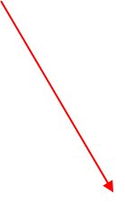
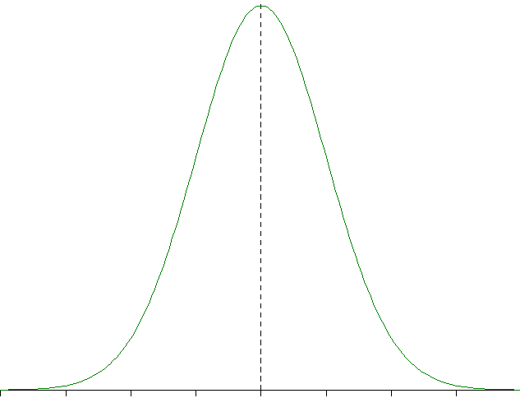
Single Imputing Method (4)
Replacing Missing by Random
Time (hrs) | 0 | 1 | 2 | 3 | 4 | 5 | 6 | 7 | 8 | 9
Patient 1 | 98 | 50 | 50 | . | 26 | . | . | 26 | 12 | 6
Patient 2 | . | 83 | 61 | . | 61 | 45 | 21 | 11 | 5 | .
 | mean | std
Patient 1 | 38.3 | 31.29
Patient 2 | 41.0 | 29.37
Random number
from N(mean, std²)

Slide 14
Single Imputing Method (4)
Replacing Missing by Random
Time (hrs) | 0 | 1 | 2 | 3 | 4 | 5 | 6 | 7 | 8 | 9
Patient 1 | 98 | 50 | 50 | 72.9 | 26 | 34.7 | 47.2 | 26 | 12 | 6
Patient 2 | 26.6 | 83 | 61 | 52.6 | 61 | 45 | 21 | 11 | 5 | 4.5
 | mean | std
Patient 1 | 38.3 | 31.29
Patient 2 | 41.0 | 29.37
Random number
from N(mean, std²)

Slide 15
SAS Tools for Imputing Methods
Methods | SAS Tools
min max mean | PROC SQL CASE VAR when . then MEAN(VAR) else VAR GROUP BY
freqmin freqmax Freamean | PROC SQL CASE VAR when . then MEAN(MostAppearingValues) else VAR GROUP BY frequency of VAR value: frq = FREQ(VAR) MostAppearingValues: HAVING frq = MAX(frq)
forward backward Average X | PROC SORT + Retain PROC SORT by DESCENDING + Retain (ForWard + BackWard) / 2 If NweValue eq . then NewValue = MAX(ForWard, BackWard)
Random | mean + std * RANNOR(0)

Slide 16
Conclusions
%SingleImpute
Provides an easy approach to dealing missing data
Offers 10 different methods (4 groups)
  min, max, mean of values
  min, max, mean of most appearing values
  carrying forward, backward, averaging
  random number based on sample mean and std
Outputs a complete SAS dataset for further analysis
Alternative way for PROC MI to handle large dataset

Slide 17


Questions ?

